Slide 1
ORM

Slide 2
Object-Relational Mapping (ORM)
Popular technique for integrating with databases
Converts data between incompatible data sources
Allows treating data sources as virtual object databases
Application
Classes
Objects
ORM
Database
Tables
Records

Slide 3
ORM Frameworks
ORMs are popular in all major languages and frameworks
Java | Python | .NET | PHP
JPA Hybernate TopLink EJB EclipseLink Kodo JDO | Django SQLAlchemy SQLObject Storm Tryton web2py Odoo | Entity Framework Dapper iBATIS LINQ to SQL NHibernate nHydrate Quick Objects | CakePHP Doctrine Qcodo QCubed Redbean Skipper Yii

Slide 4
Java Persistence API
JPA is a popular Java ORM (Object-Relational Mapping) implementation
Maps classes to SQL tables
Object instances stored into records
Object properties mapped to columns
SQL data types mapped to Object data types

Slide 5
GETTING
STARTED

Slide 6
Required Software
The following software is required to complete this lesson
JDK 8 or higher
Apache Maven - a popular industry standard build tool
MySQL Community Server - the database. Note the root password
MySQL Workbench - the database client
IntelliJ Ultimate - optional, but preferred

Slide 7
To Get Started
To get started clone the following GIT repository
https://github.com/jannunzi/db-design-orm-assignment
Type the following at the command line:
git clone https://github.com/jannunzi/db-design-orm-assignment
Open the project with your favorite IDE

Slide 8
Database Configuration
From your IDE, connect your application to a database by configuring the following files
application.properties
pom.xml
application.properties configures host, schema, username, password, etc.
pom.xml configures JDK version, database vendor version

Slide 9
Create a Spring Boot Web project
Use spring command line tool to create a project
spring init --dependencies=web myapp
Create a simple hello world webpage
mkdir myapp/src/main/webapp
cat > myapp/src/main/webapp/index.html
<h1>Hello World</h1>

Slide 10
Configuring Application Properties
Maven applications are configured in src/main/resources/application.properties
In your IDE, replace highlighted strings below with your own database host, schema, username, and password
spring.datasource.url=jdbc:mysql://YOUR_HOST:3306/YOUR_SCHEMA?serverTimezone=UTC
spring.datasource.username=YOUR_USERNAME
spring.datasource.password=YOUR_PASSWORD

Slide 11
application.properties
Additional/
Optional Configurations
spring.jpa.hibernate.ddl-auto=update
spring.jpa.show-sql=true
spring.jpa.hibernate.naming-strategy=org.hibernate.cfg.ImprovedNamingStrategy
spring.jpa.properties.hibernate.dialect=org.hibernate.dialect.MySQL5InnoDBDialect
spring.jpa.properties.hibernate.show_sql=true
spring.jpa.properties.hibernate.use_sql_comments=true
spring.jpa.properties.hibernate.format_sql=true
spring.jpa.properties.hibernate.type=trace

Slide 12
Configure Project Dependencies
pom.xml configures Maven project dependencies
In your IDE, edit pom.xml
You might need to edit your JDK version
<properties>
<java.version>8</java.version>
</properties>
JDK 8 should be OK

Slide 13
Configure Database Vendor
We've preconfigured the database vendor as MySQL using the vendor's mysql Java connector
Depending on the version of your MySQL database, you might need to configure it below
<dependency>
<groupId>mysql</groupId>
<artifactId>mysql-connector-java</artifactId>
<version>8.0.17</version>
</dependency>

Slide 14
ORM Configuration
Also verify you have the ORM libraries configured
<dependency>
<groupId>org.springframework.boot</groupId>
<artifactId>spring-boot-starter-data-jpa</artifactId>
</dependency>

Slide 15
ORM DATA
MODELLING

Slide 16
TABLES TO CLASSES

Slide 17
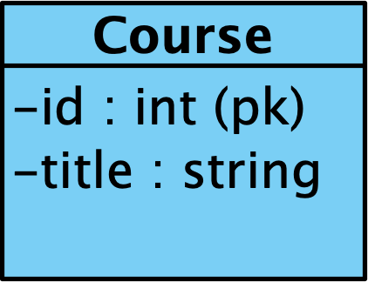
Mapping SQL Tables to Object Models
Let's map an SQL table to an object oriented data model
Consider the following table
CREATE TABLE `courses` (
`id` int(11) NOT NULL AUTO_INCREMENT,
`title` varchar(45) DEFAULT NULL,
PRIMARY KEY (`id`)
);

Slide 18
Insert Some Courses
INSERT INTO `courses` (`title`) VALUES ('cs1234');
INSERT INTO `courses` (`title`) VALUES ('cs2345');
INSERT INTO `courses` (`title`) VALUES ('cs3456');
INSERT INTO `courses` (`title`) VALUES ('cs4567');

Slide 19
Object-Relational Impedance
ORMs must consider differences between data representation
Relational model Object model
Case insensitive Case sensitive
Underscore Camel case
Plural nouns Singular nouns
Explicit primary keys Implied uniqueness
Auto increment No equivalent

Slide 20
Equivalent Object Model
Here's a potential equivalent class
Although primary key is redundant, we'll need it anyway
Chose a different name to make a later point
public class Course {
private Integer courseId;
private String title;
}

Slide 21
Declare Objects to Table Mapping
To get the ORM mapping started, we annotate our intentions with @Entity
@Entity
public class Course {
private Integer courseId;
private String title;
}

Slide 22
Table Naming Conventions
Classes are singular nouns and CamelCased
SQL Tables are plural nouns and case insensitive
@Entity
@Table(name="courses")
public class Course {
private Integer courseId;
private String title;
}
CREATE TABLE `courses` (
`id` int(11) NOT NULL,
`title` varchar(45),
PRIMARY KEY (`id`)
);

Slide 23
Primary Keys
Objects don't need primary keys, but we'll need to map it
If property differs from column name, map with @Column
public class Course {
@Column(name="id")
private Integer courseId;
}
CREATE TABLE `courses` (
`id` int(11) NOT NULL,
`title` varchar(45),
PRIMARY KEY (`id`)
);

Slide 24
Primary Keys
If class property and column names match, there's no need to map it with @Column
public class Course {
@Column(name="id")
private Integer courseId;
private String title;
}
CREATE TABLE `courses` (
`id` int(11) NOT NULL,
`title` varchar(45),
PRIMARY KEY (`id`)
);

Slide 25
Primary Keys
Map primary keys with @Id
public class Course {
@Id
@Column(name="id")
private Integer courseId;
private String title;
}
CREATE TABLE `courses` (
`id` int(11) NOT NULL,
`title` varchar(45),
PRIMARY KEY (`id`)
);

Slide 26
Auto Increment
Map auto_increment with @GeneratedValue
public class Course {
@Id
@GeneratedValue(strategy = GenerationType.IDENTITY)
@Column(name="id")
private Integer courseId;
}

Slide 27
Final Table to Object Mapping
CREATE TABLE `courses` (
`id` int(11) NOT NULL AUTO_INCREMENT,
`title` varchar(45) DEFAULT NULL,
PRIMARY KEY (`id`)
);

Slide 28
Final Table to Object Mapping
@Entity
@Table(name="courses")
public class Course {
@Id
@GeneratedValue(strategy = GenerationType.IDENTITY)
@Column(name="id")
private Integer courseId;
private String title;
}

Slide 29
CRUD REPOSITORIES

Slide 30
Repositories
DAOs implement a design pattern that encourages encapsulating data access
DAOs provide CRUD operations per table/view/collection
But need to write a DAO for each table
It'd be great to have generic DAO that could work with any table
ORM repositories implement generic/parameterizable DAOs with default CRUD operations

Slide 31
Patterns in DAOs
After implementing many DAOs we identify a pattern
A DAO for class Course would implement the interface
public interface CourseDao {
public Iterable<Course> findAllCourses();
public Course findCourseById(Integer cid);
public Course createCourse(Course course);
public Course updateCourse(Integer cid, Course course);
public void deleteCourse(Integer cid);
}

Slide 32
Patterns in DAOs
Differences are class and primary keys
A DAO for class Section would implement the interface
public interface SectionDao {
public Iterable<Section> findAllSections();
public Section findSectionById(String sid);
public Section createSection(Section section);
public Section updateSection(String sid, Section section);
public void deleteSection(String sid);
}

Slide 33
CrudRepository Interface
CrudRepository interface allow implementing generic DAOs
Just need to configure class and primary key
public interface CourseRepository
extends CrudRepository<Course, Integer> {
}

Slide 34
Repository API
Repositories provide the following generic methods
courseRepository.findAll();
courseRepository.findById(cid);
courseRepository.save(Course course);
courseRepository.deleteById(cid);

Slide 35
Repositories Make DAOs Trivial
With repositories, DAOs are now trivial
public class CourseDao {
CourseRepository courseRepository;
public Iterable<Course> findAllCourses() {
return courseRepository.findAll();
}
public Course findCourseById(Integer cid) {
return courseRepository.findById(cid).get();
}

Slide 36
Creating and Deleting Records
public class CourseDao {
public Course createCourse(Course course) {
return courseRepository.save(course);
}
public void deleteCourse(Integer cid) {
courseRepository.deleteById(cid);
}
}

Slide 37
Updating Records
To update, retrieve record, update, and then save
public class CourseDao {
public Course updateCourse
(Integer cid, Course newCourse) {
Course course = courseRepository.findById(cid).get();
course.setTitle(newCourse.getTitle());
return courseRepository.save(course);
}
}

Slide 38
TESTING
REPOSITORIES

Slide 39
HTTP Endpoints
There are many options for running/testing code
We'll expose our new DAOs as an HTTP API to we can execute them from a browser
We can expose any executable function as an HTTP endpoint by annotating classes and functions with
@RestController - class accessible on HTTP
@GetMapping - method accessible as HTTP GET
@PostMapping - method accessible as HTTP POST
@PutMapping - method accessible as HTTP PUT

Slide 40
Retrieving All Records
Mapping all courses to HTTP URL "/findAllCourses"
@RestController
public class CourseDao {
@GetMapping("/findAllCourses")
public Iterable<Course> findAllCourses() {
return courseRepository.findAll();
}}
Try it: http://localhost:8080/findAllCourses

Slide 41
Retrieving Records by ID
Mapping findCourseById to URL "/findCourseById/{cid}"
@GetMapping("/findCourseById/{cid}")
public Course findCourseById(
@PathVariable("cid") Integer cid) {
return courseRepository.findById(cid).get();
}
Try it: http://localhost:8080/findCourseById/1

Slide 42
Deleting Records
Mapping deleteCourse to URL "/deleteCourse/{cid}"
@GetMapping("/deleteCourse/{cid}")
public void deleteCourse(
@PathVariable("cid") Integer cid) {
courseRepository.deleteById(cid);
}
Try it: http://localhost:8080/deleteCourse/1

Slide 43
CLASSES
TO TABLES

Slide 44
Mapping Object Models to SQL Tables
ORMs can map data models in both directions
SQL tables to classes
Classes to tables
Consider class below. We'd like table sections
public class Section {
private Integer sectionId;
private String sectionName;
}

Slide 45
Annotating Classes as Tables
Following what we learned about mapping, class would be:
@Entity
@Table(name="sections")
public class Section {
@Id
@GeneratedValue(strategy = GenerationType.IDENTITY)
private Integer sectionId;
private String sectionName;
}

Slide 46
ORM Generated SQL
If you restart the application, the ORM generates the following SQL:
create table sections (
section_id integer not null auto_increment,
section_name varchar(255),
primary key (section_id)
) engine=InnoDB
Note names of fields use "_" instead of CamelCasing

Slide 47
ONE TO MANY

Slide 48
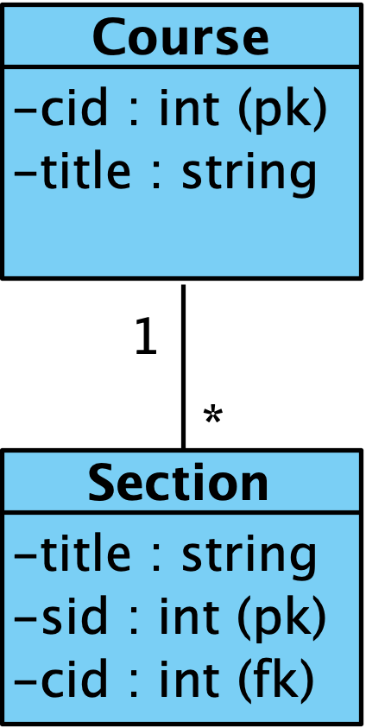
Mapping One To Many Relations
ORMs can map to various types of relationships
One to Many
Many to Many
Associations
Aggregations/Compositions
Let's explore One to Many first
Consider a one to many relation between Course and Section

Slide 49
Object Relational Impedance
In SQL one to many relationships is implemented as a foreign key on the many side referencing the one side
In Object world, one to many is implemented as a collection on the one side
ORMs must deal with this fundamental difference in implementation

Slide 50
Mapping SQL Foreign Keys
Satisfy SQL's foreign key on many side by declaring a reference to the one side
public class Section {
...
@ManyToOne
private Course course;
}
@ManyToOne annotates many side of one to many

Slide 51
Object Model One To Many
Now we need to satisfy object model's one to many implementation with a collection on the one side
public class Course {
@OneToMany(mappedBy = "course")
private List<Section> sections;
}
@OneToMany annotates the one side and "foreign key"

Slide 52
ORM Creates Relationship
create table sections (
section_id integer not null auto_increment,
section_name varchar(255),
course_id integer,
primary key (section_id)
)
alter table sections
add constraint FK7ty9cevpq04d90ohtso1q8312
foreign key (course_id)
references courses (id)

Slide 53
Let's Insert Some Sections
INSERT INTO sections VALUES (1, 'Section 123', 1);
INSERT INTO sections VALUES (2, 'Section 234', 1);
INSERT INTO sections VALUES (3, 'Section 345', 2);
INSERT INTO sections VALUES (4, 'Section 456', 2);
INSERT INTO sections VALUES (5, 'Section 567', 2);
INSERT INTO sections VALUES (6, 'Section 678', 3);

Slide 54
Avoiding Circular References
SQL joins aggregate data from multiple "flat" tables
Objects use pointers to access other object's fields
Avoid circular references in 2 way references
public class Course { public class Section {
private List<Section> sections; private Course course;
} }

Slide 55
Break Circular References
Use @JsonIgnore to break circular references
public class Section {
@ManyToOne
@JsonIgnore
private Course course;
}

Slide 56
http://localhost:8080/findAllCourses
[
{
"courseId": 1,
"title": "cs1234",
"sections": [
{
"sectionId": 7,
"sectionName": "Section 123"
},
{
"sectionId": 8,
"sectionName": "Section 234"
}
]
},
]

Slide 57
http://localhost:8080/findAllCourses
[
{
"courseId": 2,
"title": "cs2345",
"sections": [
{
"sectionId": 9,
"sectionName": "Section 345"
},
{
"sectionId": 10,
"sectionName": "Section 456"
},
{
"sectionId": 11,
"sectionName": "Section 567"
}
]
},
]

Slide 58
TEST CREATE
AND DELETE

Slide 59
Creating and Updating
Let's first test creating and updating courses
DAO methods might be
public Course createCourse(Course course) {
return repository.save(course);
}
public void deleteCourse(Integer courseId) {
repository.deleteById(courseId);
}

Slide 60
Testing Deleting Records
Testing deleteCourse() is easy. We can just map a simple URL
@GetMapping("/deleteCourse/{courseId}")
public void deleteCourse(
@PathVariable("courseId") Integer courseId) {
repository.deleteById(courseId);
}

Slide 61
Testing Deleting Records
To test we can point our browser to
http://localhost:8080/deleteCourse/2
Querying courses table in database shows missing record
select * from courses
'1','cs1234' missing
'3','cs3456'
'4','cs4567'
'5','cs5678'

Slide 62
Testing Creating Records
Testing createCourse() is more involved since it expects an object. Instead let's just work with a title
@GetMapping("/createCourse/{title}")
public Course createCourse(
@PathVariable("title") String title) {
Course course = new Course();
course.setTitle(title);
return createCourse(course);
}
Overload DAO's create method with a version that accepts title as String

Slide 63
Testing Creating Records
To test we can point our browser to
http://localhost:8080/createCourse/cs5678
And the application responds with the new course
{
"courseId": 5,
"title": "cs5678",
"sections": null
}
Querying courses table in database shows new course record
select * from courses
'1','cs1234'
'2','cs2345'
'3','cs3456'
'4','cs4567'
'5','cs5678'

Slide 64
USING ONE
TO MANY

Slide 65
Managing Single Table/Object
Working with a single table/object ORM implements CRUD
Find all records/objects
Find single record/object by its ID
Create single record/object
Delete single record/object by its ID
Update single record/object by its ID
We've already implemented these

Slide 66
Managing One to Many relationships
It's often useful to use parent/child analogy
Working with one to many relation between records the ORM needs to support:
Add child record to parent record
Remove child record from parent record
Given a parent record, what are its child records?
Given a child record, what is its parent record?
Let's implement these next

Slide 67
Section Repository
First, all objects mapped by an ORM must have corresponding repository
public interface SectionRepository
extends CrudRepository<Section, Integer> {
}

Slide 68
Section DAO
And its corresponding DAO with CRUD
public class SectionDao {
public Iterable<Section> findAllSections() { … }
public Section findSectionById(Integer cid) { … }
public Section createSection(String title) { … }
public void deleteSection(Integer sectionId) { … }
public void deleteSection(Integer sectionId) { … }
}

Slide 69
CourseSectionDao
We'll implement the One to Many relation between Course and Section in a DAO that uses both repositories
public class CourseSectionDao {
CourseRepository courseRepository;
SectionRepository sectionRepository;
...
}

Slide 70
Add Section to Course
Set the child's foreign key to establish the one to many relation
public Course addSectionToCourse(
Integer sectionId,
Integer courseId) {
Course course = courseRepository.findById(courseId).get();
Section section = sectionRepository.findById(sectionId).get();
course.getSections().add(section);
section.setCourse(course);
sectionRepository.save(section);
return course;
}

Slide 71
Testing Add Section to Course
@GetMapping("/addSection/{sectionId}/toCourse/{courseId}")
public Course addSectionToCourse(
@PathVariable("sectionId") Integer sectionId,
@PathVariable("courseId") Integer courseId) {
Course course = courseRepository.findById(courseId).get();
Section section = sectionRepository.findById(sectionId).get();
course.getSections().add(section);
section.setCourse(course);
sectionRepository.save(section);
return course;
}

Slide 72
Test Adding Section to Course
http://localhost:8080/addSection/13/toCourse/6
{ "courseId": 6,
"title": "courseAAA",
"sections": [
{ "sectionId": 13,
"title": "sectionAAA1" },
]}

Slide 73
Adding Another Section to Course
http://localhost:8080/addSection/14/toCourse/6
{ "courseId": 6,
"title": "courseAAA",
"sections": [
{ "sectionId": 13,
"title": "sectionAAA1" },
{ "sectionId": 14,
"title": "sectionAAA2"}
]}

Slide 74
Remove Section from Course
To remove the relation, set the child's fk to null
public Course removeSectionFromCourse(
Integer sectionId,
Integer courseId) {
Course course = courseRepository.findById(courseId).get();
Section section = sectionRepository.findById(sectionId).get();
course.getSections().remove(section);
section.setCourse(null);
sectionRepository.save(section);
return course;
}

Slide 75
Testing Remove Section from Course
@GetMapping("/removeSection/{sectionId}/fromCourse/{courseId}")
public Course removeSectionFromCourse(
@PathVariable("sectionId") Integer sectionId,
@PathVariable("courseId") Integer courseId) {
Course course = courseRepository.findById(courseId).get();
Section section = sectionRepository.findById(sectionId).get();
course.getSections().remove(section);
section.setCourse(null);
sectionRepository.save(section);
return course;
}

Slide 76
Testing Remove Section from Course
http://localhost:8080/removeSection/14/fromCourse/6
{ "courseId": 6,
"title": "courseAAA",
"sections": [
{ "sectionId": 13,
"title": "sectionAAA1"}
]}

Slide 77
MANY TO MANY

Slide 78
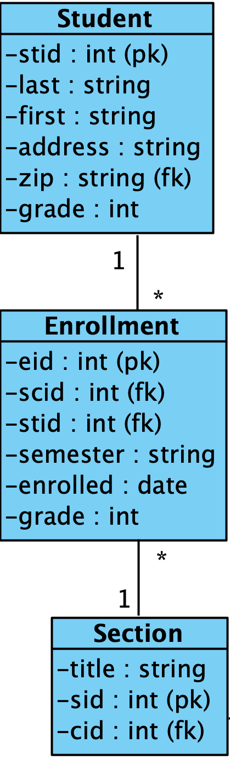
Mapping Many To Many Relations
ORMs can map to various types of relationships
One to Many
Many to Many
Associations
Aggregations/Compositions
Let's take a look at Many to Many
Consider a many to many relation between Section, Enrollment and Student ✔

Slide 79
Student Class
Mapping class to SQL table is easy with ORMs
@Entity
@Table(name="students")
public class Student {
@Id
@GeneratedValue(strategy = GenerationType.IDENTITY)
private Integer studentId;
private String first;
private String last;
}

Slide 80
students Table
ORM creates table for us
create table students (
student_id integer not null auto_increment,
first varchar(255),
last varchar(255),
primary key (student_id)
) engine=InnoDB

Slide 81
Insert Some Students
INSERT INTO `students`
VALUES (null, 'Alice', 'Wonderland');
INSERT INTO `students`
VALUES (null, 'Bob', 'Hope');
INSERT INTO `students`
VALUES (null, 'Charlie', 'Brown');

Slide 82
Student Repository
All ORM managed records/objects can be accessed through their repository
public interface StudentRepository
extends CrudRepository<Student, Integer> {
}

Slide 83
StudentDao is Trivial
Implementing DAOs is trivial using repositories
public class StudentDao {
@Autowired
StudentRepository repository;
public Iterable<Student> findAllStudents() {
return repository.findAll();
}
}

Slide 84
Mapping DAOs to HTTP URLs is Trivial
Mapping DAOs to HTTP URLs for testing and integration
@RestController
public class StudentDao {
@Autowired
StudentRepository repository;
@GetMapping("/findAllStudents")
public Iterable<Student> findAllStudents() {
return repository.findAll();
}
}

Slide 85
http://localhost:8080/findAllStudents
[
{
"studentId": 1,
"first": "Alice",
"last": "Wonderland"
},
{
"studentId": 2,
"first": "Bob",
"last": "Marley"
},
{
"studentId": 3,
"first": "Charlie",
"last": "Brown"
}
]
Making data accessible through HTTP interfaces makes it easy to integrating databases with mobile and Web applications

Slide 86
Section Class
@Entity
@Table(name="sections")
public class Section {
@Id
@GeneratedValue(strategy = GenerationType.IDENTITY)
private Integer sectionId;
private String sectionName;
}

Slide 87
sections Table
create table sections (
section_id integer not null auto_increment,
section_name varchar(255),
course_id integer,
primary key (section_id)
) engine=InnoDB

Slide 88
Implementing Composite Keys
Let's relate Students and Sections through Enrollments
Implement composite Key
public class EnrollmentId
implements Serializable {
private Integer studentId;
private Integer sectionId;
}

Slide 89
EnrollmentId.equals()
public class EnrollmentId implements Serializable {
public boolean equals(Object object) {
if (object instanceof EnrollmentId) {
EnrollmentId otherId = (EnrollmentId) object;
return (otherId.studentId == this.studentId)
&& (otherId.sectionId == this.sectionId);
}
return false;
}
}

Slide 90
Enrollment Class
@Entity
@Table(name="enrollments")
@IdClass(EnrollmentId.class)
public class Enrollment {
@Id
private Integer studentId;
@Id
private Integer sectionId;
private Float grade;
}
Implement
1 Many to Many
as
2 One to Many
(Reify)

Slide 91
Enrollment.student
public class Enrollment {
@ManyToOne
@PrimaryKeyJoinColumn
(name="studentId",
referencedColumnName="studentId")
@JsonIgnore
private Student student;
}

Slide 92
Enrollment.section
public class Enrollment {
@ManyToOne
@PrimaryKeyJoinColumn
(name="sectionId",
referencedColumnName="sectionId")
@JsonIgnore
private Section section;
}

Slide 93
courses Table
create table courses (
id integer not null auto_increment,
title varchar(255),
primary key (id)
) engine=InnoDB

Slide 94
enrollments Table
ORM create mapping table for us
create table enrollments (
section_id integer not null,
student_id integer not null,
grade float,
section_section_id integer,
student_student_id integer,
primary key (section_id, student_id)
) engine=InnoDB

Slide 95
Foreign Key Constraints
And ORM adds referencial constraints
alter table enrollments
add constraint FK2klr8kudlsyl5h0djk56jmbhi
foreign key (section_section_id)
references sections (section_id)
alter table enrollments
add constraint FKjw3x10w9mswhngwpg7gimmvxq
foreign key (student_student_id)
references students (student_id)

Slide 96
Foreign Key Constraints
alter table sections
add constraint FK7ty9cevpq04d90ohtso1q8312
foreign key (course_id)
references courses (id)

Slide 97
HTTP API for Testing
@RestController
public class StudentDao {
@GetMapping("/findAllStudents")
public Iterable<Student> findAllStudents() { … }
@GetMapping("/findStudentById/{sid}")
public Student findStudentById(
@PathVariable("sid") Integer studentId) { … }
}

Slide 98
Insert Some Sections
INSERT INTO `sections`
VALUES (null, 'Section R', null);
INSERT INTO `sections`
VALUES (null, 'Section S', null);
INSERT INTO `sections`
VALUES (null, 'Section T', null);
Let's insert some sections and then enroll some students in them

Slide 99
Insert Some Enrollments
INSERT INTO `enrollments`
VALUES ('18', '1', '85', '18', '1');
INSERT INTO `enrollments`
VALUES ('18', '2', '90', '18', '2');
INSERT INTO `enrollments`
VALUES ('19', '2', '95', '19', '2');
Now let's enroll some students in the section we just created
Note: IDs might not be same as yours

Slide 100
Add Sections to Students
@Entity
@Table(name="students")
public class Student {
@Id
@GeneratedValue(strategy = GenerationType.IDENTITY)
private Integer studentId;
private String first;
private String last;
@OneToMany(mappedBy = "student")
private List<Enrollment> sections;
}

Slide 101
Add Students to Section
@Entity
@Table(name="sections")
public class Section {
@Id
@GeneratedValue(strategy = GenerationType.IDENTITY)
private Integer sectionId;
private String sectionName;
@OneToMany(mappedBy="section")
private List<Enrollment> students;
}

Slide 102
http://localhost:8080/findAllStudents
[
{
"studentId": 1,
"first": "Alice",
"last": "Wonderland",
"sections": [
{
"studentId": 1,
"sectionId": 1,
"grade": 90
},
{
"studentId": 1,
"sectionId": 2,
"grade": 100
}
]
},
]

Slide 103
http://localhost:8080/findAllStudents
[
{
"studentId": 2,
"first": "Bob",
"last": "Marley",
"sections": [
{
"studentId": 2,
"sectionId": 1,
"grade": 95
}
]
},
]

Slide 104
http://localhost:8080/findAllStudents
[
{
"studentId": 3,
"first": "Charlie",
"last": "Brown",
"sections": [
{
"studentId": 3,
"sectionId": 2,
"grade": 80
}
]
},
]

Slide 105
http://localhost:8080/findAllStudents
[
{
"studentId": 4,
"first": "Dan",
"last": "Aykroyd",
"sections": []
},
{
"studentId": 5,
"first": "Ed",
"last": "Norton",
"sections": []
}
]

Slide 106
USING MANY
TO MANY

Slide 107
EnrollmentRepository
To use our Many to Many relation, create a repository
Note EnrollmentId represents its composite primary key
public interface EnrollmentRepository
extends CrudRepository<Enrollment, EnrollmentId> {
}

Slide 108
EnrollmentDao
To use our Many to Many relation, create a DAO for it
It'll need repositories for tables/objects it relates
public class EnrollmentDao {
@Autowired
StudentRepository studentRepository;
@Autowired
SectionRepository sectionRepository;
@Autowired
EnrollmentRepository enrollmentRepository;
}

Slide 109
Inserting a Relationship
Create the relation, set its foreign keys, and insert it
public Enrollment enrollStudentInSection(
Integer studentId,
Integer sectionId) {
Enrollment enrollment = new Enrollment();
enrollment.setSectionId(sectionId);
enrollment.setStudentId(studentId);
enrollmentRepository.save(enrollment);
return enrollment;
}

Slide 110
Testing enrollStudentInSection
@RestController
public class EnrollmentDao {
@GetMapping("/enroll/{studentId}/in/{sectionId}")
public Enrollment enrollStudentInSection(
@PathVariable("studentId") Integer studentId,
@PathVariable("sectionId") Integer sectionId) {
Enrollment enrollment = new Enrollment();
enrollment.setSectionId(sectionId);
enrollment.setStudentId(studentId);
enrollmentRepository.save(enrollment);
return enrollment;
}

Slide 111
Deleting a Relationship
To remove relationship, create composite key, and delete
public void unenrollStudentFromSection(
Integer studentId,
Integer sectionId) {
EnrollmentId enrollmentId = new EnrollmentId();
enrollmentId.setStudentId(studentId);
enrollmentId.setSectionId(sectionId);
enrollmentRepository.deleteById(enrollmentId);
}

Slide 112
Testing unenrollStudentFromSection
@GetMapping("/unenroll/{studentId}/from/{sectionId}")
public void unenrollStudentFromSection(
@PathVariable("studentId") Integer studentId,
@PathVariable("sectionId") Integer sectionId) {
EnrollmentId enrollmentId = new EnrollmentId();
enrollmentId.setStudentId(studentId);
enrollmentId.setSectionId(sectionId);
enrollmentRepository.deleteById(enrollmentId);
}

Slide 113
INHERITANCE
JPA CLASS
Dr. Jose Annunziato

Slide 114
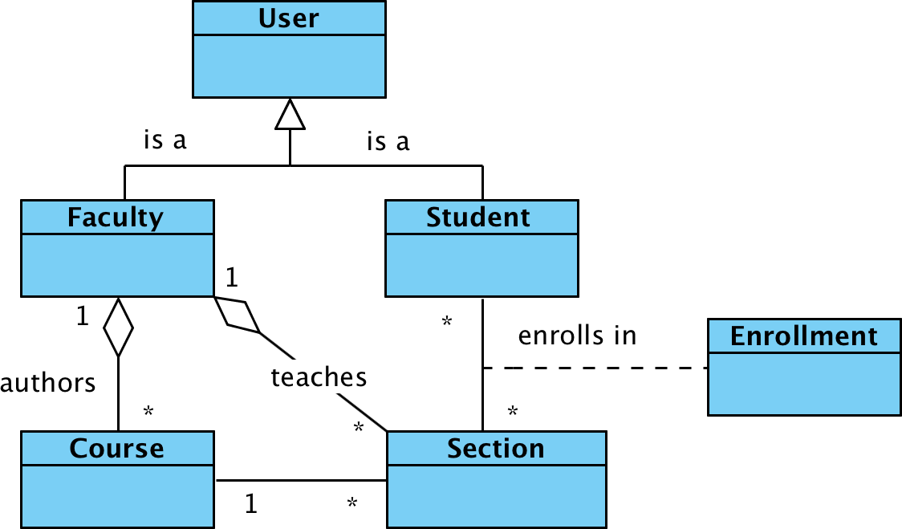

Slide 115
Java entity data models
package com.example.myapp.models;
public class User {
private String username;
private String password;
private String firstName;
private String lastName;
}
The following were left out for brevity
setters
getters
all arguments constructor
default constructor

Slide 116
Annotate models as JPA entities
import javax.persistence.*;
@Entity
public class User {
@Id
@GeneratedValue
(strategy=GenerationType.IDENTITY)
private int id;
}
JPA maps Java classes to database tables, properties to fields, and instances to records

Slide 117
Implement repository
Repositories provide API to interact with database, e.g., create, find, update, delete
package com.example.myapp.repositories;
import com.example.myapp.models.*;
import org.springframework.data.repository.*;
public interface UserRepository
extends CrudRepository<User, Integer> { }

Slide 118
Generated JPA Schema
CREATE TABLE user (
id int(11) NOT NULL AUTO_INCREMENT,
first_name varchar(255) DEFAULT NULL,
last_name varchar(255) DEFAULT NULL,
password varchar(255) DEFAULT NULL,
username varchar(255) DEFAULT NULL,
PRIMARY KEY (id)
) ENGINE=MyISAM DEFAULT CHARSET=latin1;

Slide 119
Insert some users
INSERT INTO user VALUES
('Alice','Wonderland','awonder','123');
INSERT INTO user VALUES
('Bob','Dylan','bdylan','qwe');
INSERT INTO user VALUES
('Chuck','Norris','cnorris','wer');
INSERT INTO user VALUES
('Dan','Brown','dbrown','asd');

Slide 120
CUSTOM JPQL QUERIES
Dr. Jose Annunziato

Slide 121
Implementing custom queries
Declare custom queries in repository
public interface UserRepository
extends CrudRepository<User, Integer> {
public List<User>
findUserByUsername
(String username);
}

Slide 122
Naming query parameters
Name method parameters so we can refer to them in a query
public List<User> findUserByUsername
(@Param("username") String username);

Slide 123
Referencing query parameters
Implement query with @Query. Use JPQL or native SQL
@Query("SELECT user FROM User user
WHERE user.username=:username")
public List<User> findUserByUsername
(@Param("username") String username);

Slide 124
Combine predicates with AND
Use AND to combine predicates
@Query("SELECT user from User user WHERE user.username=:username AND user.password=:=password")
public List<User> findUserByCredentials
(@Param("username") String username,
@Param("password") String password);

Slide 125
WEB SERVICE DATA ACCESS
Dr. Jose Annunziato

Slide 126
Retrieve a record by primary key
Use repository's findById() to retrieve one record
@GetMapping("/api/users/{userId}")
public User findUserById
(@PathVariable("userId") Integer id) {
return userRepository.findById(id).get();
}
Try http://localhost:8080/api/users/1

Slide 127
Expose data model as a REST API
Map data model to equivalent REST API endpoint
@RestController
public class UserService {
@GetMapping("/api/users")
public List<User> findAllUsers() { }
}

Slide 128
Retrieve all records
Use repository's findAll() method to retrieve all records
@Autowired
UserRepository userRepository;
@GetMapping("/api/users")
public List<User> findAllUsers() {
return (List<User>) userRepository.findAll();
}
Try http://localhost:8080/api/users

Slide 129
Retrieve users by username
@GetMapping("/api/users")
public List<User> findAllUsers(@RequestParam
(name="username", required=false) String uname)
{ if(username != null) {
return userRepository.
findUserByUsername(uname); }
return (List<User>) userRepository.findAll();
}

Slide 130
UPDATE DATA IN REST SERVICES
Dr. Jose Annunziato

Slide 131
Posting New Data to RESTful Services
@PostMapping("/api/users")
public User createUser
(@RequestBody User user) {
return userRepository
.save(user);
}

Slide 132
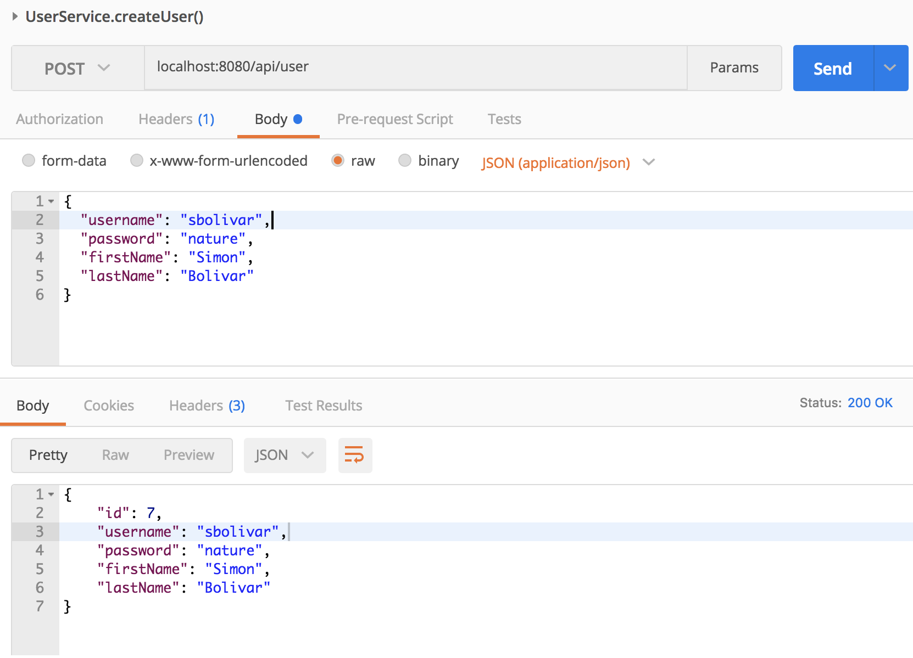

Slide 133
Updating Data in RESTful Services
@PutMapping("/api/users/{userId}")
public User updateUser(
@PathVariable("userId") int id,
@RequestBody User newUser) {
User user = userRepository.findById(id).get();
user.set(newUser);
return userRepository.save(user);}

Slide 134
Updating Data in RESTful Services
public void set(User newUser) {
this.username = newUser.username;
this.password = newUser.password;
this.firstName = newUser.firstName;
this.lastName = newUser.lastName;
}

Slide 135
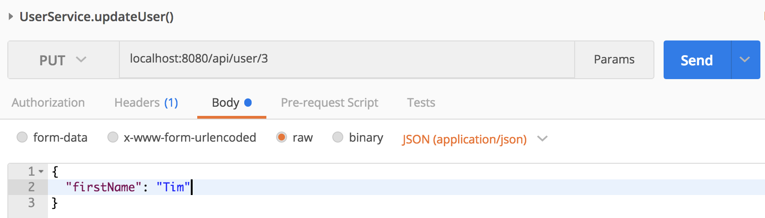

Slide 136
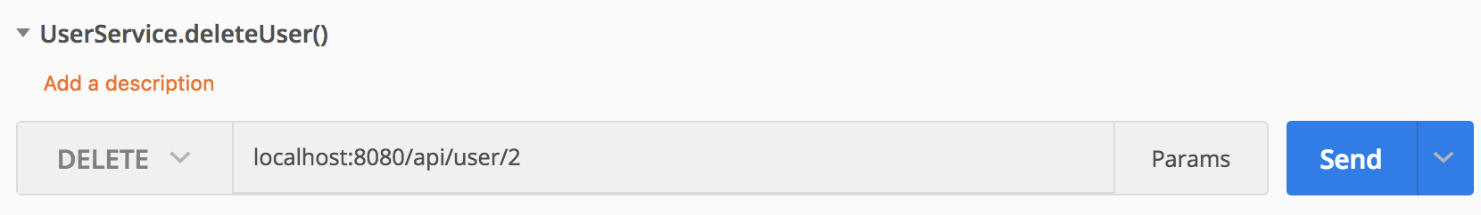
Deleting Data from RESTful Services
@DeleteMapping("/api/users/{userId}")
public void deleteUser
(@PathVariable("userId") int id) {
userRepository.deleteById(id);
}

Slide 137
FACULTY
ENTITY MODEL
Dr. Jose Annunziato

Slide 139
Implementing Inheritance
package com.jga.models;
public class Faculty extends User {
private String office;
private Boolean tenure;
}
setters
getters
all arguments constructor
default constructor

Slide 140
Single Table Inheritance Strategy (default)
CREATE TABLE users (
id int(11) NOT NULL AUTO_INCREMENT,
first_name varchar(255) DEFAULT NULL,
last_name varchar(255) DEFAULT NULL,
password varchar(255) DEFAULT NULL,
username varchar(255) DEFAULT NULL,
dtype varchar(31) NOT NULL,
office varchar(255) DEFAULT NULL,
tenure bit(1) DEFAULT NULL,
PRIMARY KEY (id)
);
Default strategy is single table inheritance. Derived class attributes are denormalized to base class. dtype used to distinguish.

Slide 141
Implementing a Faculty Repository
package com.jga.repositories;
import org.springframework.data.repository.*;
import com.jga.models.Faculty;
public interface FacultyRepository extends CrudRepository<Faculty, Integer> { }

Slide 142
Faculty REST Service
Repository's findAll() only returns instances of Faculty.
Automatically filters
dType='Faculty'
@RestController
public class FacultyService {
@Autowired
FacultyRepository repository;
@GetMapping("/api/faculty")
public List<Faculty> findAllFaculty() {
return (List<Faculty>)repository.findAll();
}}

Slide 143
Insert a Faculty
INSERT INTO users
(first_name, last_name, password,
username, dtype, office, tenure)
VALUES
('Tim','Birns Lee', 'tlee', 'tlee',
'Faculty', '123A', 1);

Slide 144
Insert Another Faculty
INSERT INTO users
(first_name, last_name, password,
username, dtype, office, tenure)
VALUES
('Ada','Lovelace','alovelace',
'alovelace','Faculty','321B',1);

Slide 145
http://localhost:8080/api/faculty
[ { "id": 3, "username": "tlee",
"password": "tlee", "firstName": "Tim", "lastName": "Birns Lee",
"office": "123A", "tenure": true },
{ "id": 4, "username":"alovelace",
"password":"alovelace", "firstName":
"Ada", "lastName": "Lovelace",
"office": "321B", "tenure": true } ]

Slide 146
STUDENT ENTITY
Dr. Jose Annunziato

Slide 148
Implementing Inheritance
package com.jga.models;
@Entity
public class Student extends User {
private float gpa;
private int graduationYear;
}
setters
getters
all arguments constructor
default constructor

Slide 149
Student Repository
package com.jga.repositories;
import org.springframework.data.repository.*;
import com.jga.models.Student;
public interface StudentRepository
extends CrudRepository
<Student, Integer> { }

Slide 150
Student REST Service
@RestController
public class StudentService {
@Autowired
StudentRepository repository;
@GetMapping("/api/students")
public List<Student> findAllStudents()
{ return (List<Student>)repository.findAll(); }}

Slide 151
Single Table Inheritance Strategy (default)
CREATE TABLE users (
id int(11) NOT NULL AUTO_INCREMENT,
-- first_name, last_name, password, username
dtype varchar(31) NOT NULL,
office varchar(255) DEFAULT NULL,
tenure bit(1) DEFAULT NULL,
gpa float DEFAULT NULL,
graduation_year int(11) DEFAULT NULL,
)

Slide 152
Insert a Student
INSERT INTO users
(first_name,last_name,password,
username,dtype,gpa,
graduation_year)
VALUES
('Dan','Craig','craig','dcraig',
'Student','3.7','2021');

Slide 153
Insert Another Student
INSERT INTO users
(first_name,last_name,password,
username,dtype,gpa,
graduation_year)
VALUES
('Charlie','Garcia','charlie',
'cgarcia','Student',3.8,2019);

Slide 154
http://localhost:8080/api/students
[ { "id": 5,
"username": "cgarcia", "password": "charlie",
"firstName": "Charlie","lastName": "Garcia",
"gpa": 3.8, "graduationYear": 2019 },
{ "id": 6,
"username": "dcraig", "password": "craig",
"firstName": "Dan", "lastName": "Craig",
"gpa": 3.7, "graduationYear": 2021 }
]

Slide 155
MANY
ONE TO
Dr. Jose Annunziato

Slide 157
One to Many Relations
public class Faculty extends User {
...
@OneToMany(mappedBy="author")
private List<Course> authoredCourses;
}
Use @JsonIgnored to avoid circular references

Slide 158
Implementing a Course Entity Data Model
@Entity
@Table(name="courses")
public class Course { ...
@Id ...
private int id;
private String name;
@ManyToOne()
@JsonIgnore
private Faculty author;
}
@JsonIgnore
is optional but recommended
to avoid recursive JSON mapping

Slide 159
Generated JPA Course Schema
CREATE TABLE courses (
id int(11) NOT NULL AUTO_INCREMENT,
name varchar(255) DEFAULT NULL,
author_id int(11) DEFAULT NULL,
PRIMARY KEY (id),
KEY ... (author_id),
FOREIGN KEY (author_id) REFERENCES user (id)
)

Slide 160
Implementing authoredCourse()
public class Faculty extends User { ...
private List<Course> authoredCourses;
public void authoredCourse(Course course)
{ this.authoredCourses.add(course);
if(course.getAuthor() != this) {
course.setAuthor(this);
}}}

Slide 161
Implementing setAuthor()
public class Course {
public void setAuthor(Faculty author) {
this.author = author;
if(!author.getAuthoredCourses().contains(this)) {
author.getAuthoredCourses().add(this);
}}}

Slide 162
TESTING ONE TO MANY
Dr. Jose Annunziato

Slide 163
Testing One to Many Relations
To test one to many relation between faculty and the courses they authored, we're going to:
Create a new course
Add the course to an existing faculty
Find the faculty's authored courses
Find the course's author (inverse relation)

Slide 164
Implement a Course Repository
package com.jga.repositories;
import org.springframework.data.repository.*;
import com.jga.models.Course;
public interface CourseRepository extends
CrudRepository<Course, Integer> { }

Slide 165
Implement Post New Course
@RestController
public class CourseService {
@Autowired
CourseRepository courseRepository;
@PostMapping("/api/courses")
public Course createCourse
(@RequestBody Course course) {
return courseRepository.save(course);
}}

Slide 166
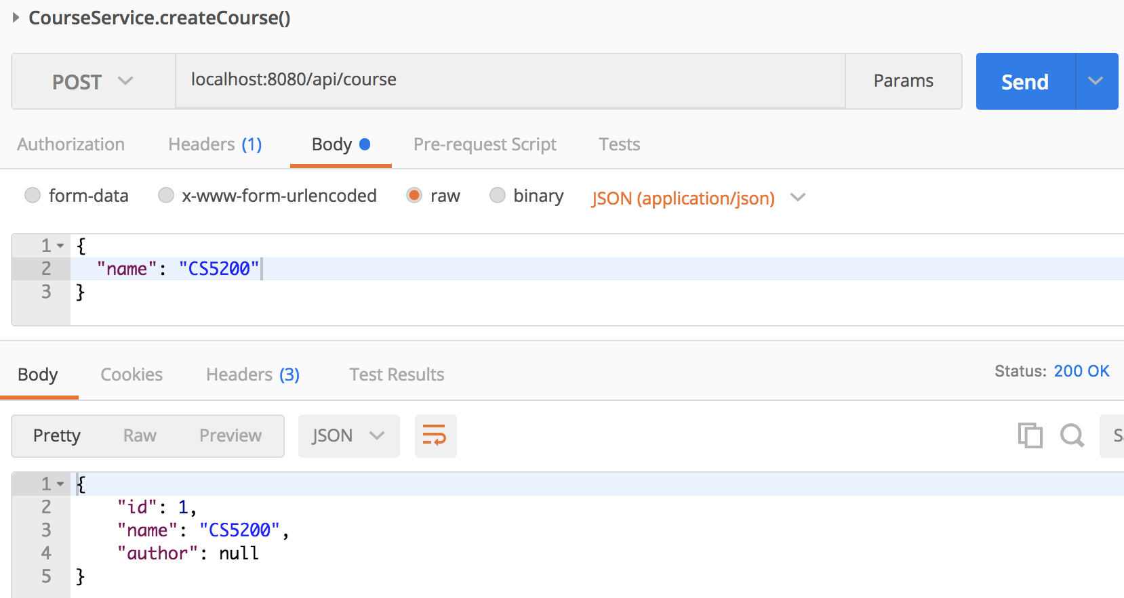

Slide 167
MANY
MANY TO
Dr. Jose Annunziato

Slide 168
FacultyService.authoredCourse()
@PutMapping("/api/faculty/{fId}/authored/{cId}")
public void authoredCourse(
@PathVariable("fId") int fId,
@PathVariable("cId") int cId) {
Faculty faculty = facultyRepository.findOne(fId);
Course course = courseRepository.findOne(cId);
course.setAuthor(faculty);
courseRepository.save(course);
faculty.authoredCourse(course);
facultyRepository.save(faculty);
}
⇐
use either
⇐

Slide 169
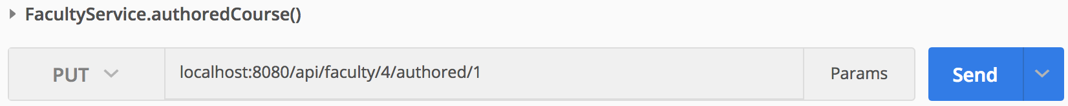
Test authoredCourse()

Slide 170
Implement Find Authored Courses
public class FacultyService {...
@GetMapping
("/api/faculty/{facultyId}/authored")
public Iterable<Course> findAuthoredCourses(
@PathVariable("facultyId") int fId) {
Faculty faculty =
facultyRepository.findOne(fId);
return faculty.getAuthoredCourses();
}}

Slide 171
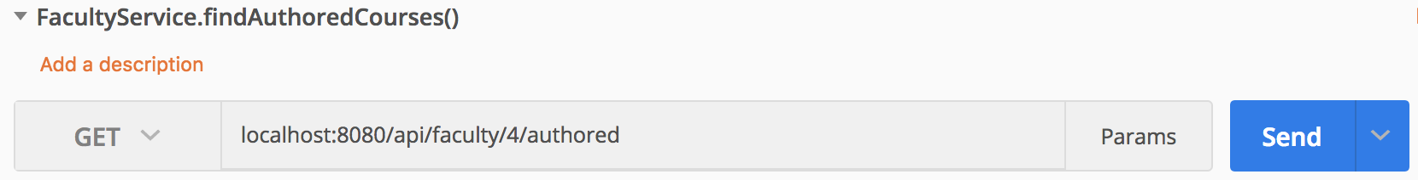
Implement Find Authored Courses
[
{ "id": 1, "name": "CS5200" },
{ "id": 2, "name": "CS5610" }
]

Slide 172
Find a Course Author
public class CourseService {
@GetMapping("/api/course/{courseId}/author")
public Faculty findCourseAuthor(
@PathVariable("courseId") int cId) {
Course course =
courseRepository.findOne(cId);
return course.getAuthor();
}
}

Slide 173
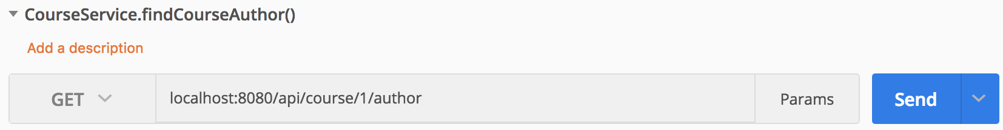
Find a Course Author
{
"id": 4,
"username":"alovelace","password":"123",
"firstName":"Ada","lastName":"Lovelace",
"office": "321B", "tenure": true
}

Slide 174
MANY
MANY TO
Dr. Jose Annunziato

Slide 176
Implement Section JPA Entity Data Model
@Entity
public class Section { ...
@Id ...
private String name;
@ManyToMany(mappedBy="enrolledSections")
@JsonIgnore
private List<Student> enrolledStudents;
}

Slide 177
Add Bi-Directional Relation
public class Student extends User { ...
@ManyToMany
@JoinTable(name="ENROLLMENT",
joinColumns=@JoinColumn(name="STUDENT_ID",
referencedColumnName="ID"),
inverseJoinColumns=@JoinColumn(name=
"SECTION_ID", referencedColumnName="ID"))
@JsonIgnore
private List<Section> enrolledSections;

Slide 178
ENROLLMENT
CREATE TABLE enrollment (
student_id int(11) NOT NULL,
section_id int(11) NOT NULL,
KEY ... (section_id),
KEY ... (student_id),
FOREIGN KEY (section_id)
REFERENCES section (id),
FOREIGN KEY (student_id)
REFERENCES user (id)
)

Slide 179
POST NEW SECTIONS
Dr. Jose Annunziato

Slide 180
Implement Section Repository
package com.jga.repositories;
import
org.springframework.data.repository.*;
import com.jga.models.Section;
public interface SectionRepository extends
CrudRepository<Section, Integer> { }

Slide 181
Implement Section Service
@RestController
public class SectionService {
@Autowired
SectionRepository sectionRepository;
@PostMapping("/api/section")
public Section createSection
(@RequestBody Section section) {
return sectionRepository.save(section);
}}

Slide 182
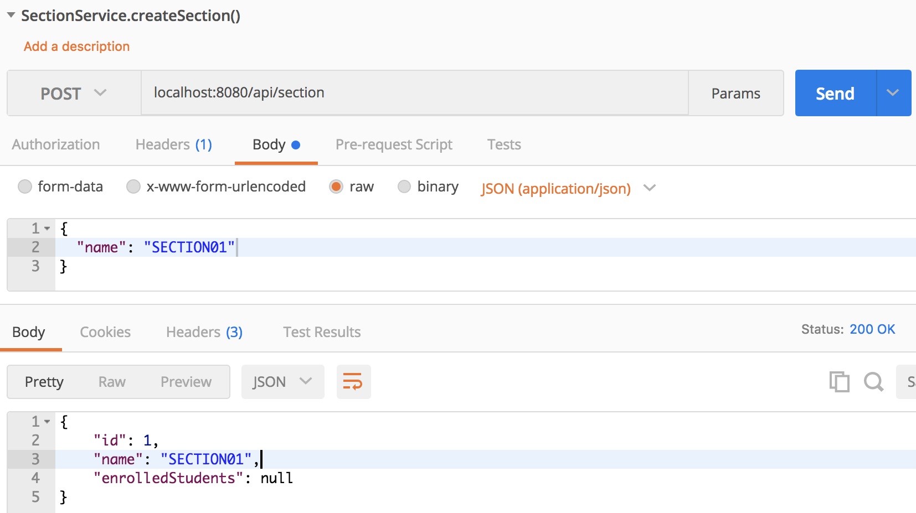
Post a New Section

Slide 183
Insert Another Section
INSERT INTO
section (name)
VALUES
('SECTION02');

Slide 184
Implement findAllSections()
public class SectionService {
@GetMapping("/api/section")
public Iterable<Section>
findAllSections() {
return
sectionRepository.findAll();
}}

Slide 185
http://localhost:8080/api/section
[ { "id": 1, "name": "SECTION01",
"enrolledStudents": []
},
{ "id": 2, "name": "SECTION02",
"enrolledStudents": []
}]

Slide 186
ENROLL STUDENTS IN SECTIONS
Dr. Jose Annunziato

Slide 187
Add Section.enrollStudent()
public class Section {
private List<Student> enrolledStudents;
public void enrollStudent(Student student) {
this.enrolledStudents.add(student);
if(!student.getEnrolledSections()
.contains(this)) {
student.getEnrolledSections()
.add(this);
}}}

Slide 188
Add Student.enrollSection()
public class Student extends User {
private List<Section> enrolledSections;
public void enrollSection(Section section) {
this.enrolledSections.add(section);
if(!section.getEnrolledStudents()
.contains(this)) {
section.getEnrolledStudents()
.add(this);
}}}

Slide 189
SectionService.enrollStudentInSection()
public class SectionService {
@Autowired
StudentRepository studentRepository;
@PostMapping("/api/section/{zId}/student/{sId}")
public void enrollStudentInSection(
@PathVariable("zId") int zId,
@PathVariable("sId") int sId) {
Section section = sectionRepository.findOne(zId);
Student student = studentRepository.findOne(sId);
section.enrollStudent(student);
sectionRepository.save(section);
}}

Slide 190
StudentService.enrollStudentInSection()
public class StudentService {
@Autowired
SectionRepository sectionRepository;
@PostMapping("/api/student/{sId}/section/{zId}")
public void enrollStudentInSection(
@PathVariable("zId") int zId,
@PathVariable("sId") int sId) {
Section section = sectionRepository.findOne(zId);
Student student = studentRepository.findOne(sId);
student.enrollSection(section);
studentRepository.save(student);
}}

Slide 191
Query STUDENT_SECTION
SELECT * FROM course-manager.student_section;
student_id section_id
-----------------------
6 2
5 1

Slide 192
RETRIEVING ENROLLMENTS
Dr. Jose Annunziato

Slide 193
Retrieve Student Enrollments
public class StudentService {
@GetMapping("/api/student/{sId}/section")
public Iterable<Section>
findStudentEnrolledSections(
@PathVariable("sId") int sId) {
Student student =
studentRepository.findOne(sId);
return student.getEnrolledSections();
}}

Slide 194
Retrieve Section Enrollments
public class SectionService {
@GetMapping("/api/section/{sId}/student")
public Iterable<Student>
findSectionEnrolledStudents(
@PathVariable("sId") int sId) {
Section section =
sectionRepository.findOne(sId);
return section.getEnrolledStudents();
}}

Slide 195
Testing Enrollment
http://localhost:8080/api/student/5/section
[{"id": 1,"name": "SECTION01"}]
http://localhost:8080/api/section/1/student
[{"id": 5,"username": "cgarcia","password": "charlie","firstName": "Charlie","lastName": "Garcia","gpa": 3.8,"graduationYear": 2019}]

